Slide 1
Network Analysis Of Languages in the Sub-Continent
By:
Anisa Aisha Ahmed (aa04049)
Farooq Abdul Rehman (fr04020)

Slide 2
Research Questions
How related are the languages that exist in the sub-continent?
We will be focusing on Persian, Arabic, Sanskrit, Hindustani (Hindi and Urdu) languages.
How did these languages originate?
Which language was the oldest among these languages?
How did the evolution of languages take place?

Slide 3
Nodes and Entity Relationships
Nodes represent words of various languages.
Relations represent the inter-connectedness of languages.
We examine the inter-connectedness of languages on the basis of two factors.
Relations representing the similarity in meaning of words.
Relations representing the origin of words, that is, hierarchical relation where the origin of word is indicated.

Slide 4
Methodology for Data Collection
Our main sources of data collection are different etymological dictionaries.
Platt’s Dictionary
Research articles

Slide 5
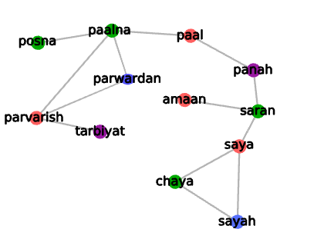
Demo Network
Blue = Persian
Green = Sanskrit
Red = Hindustani
Purple = Hindustani-Persian

